Slide 1
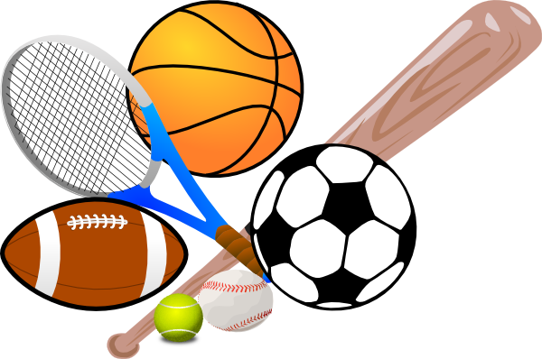
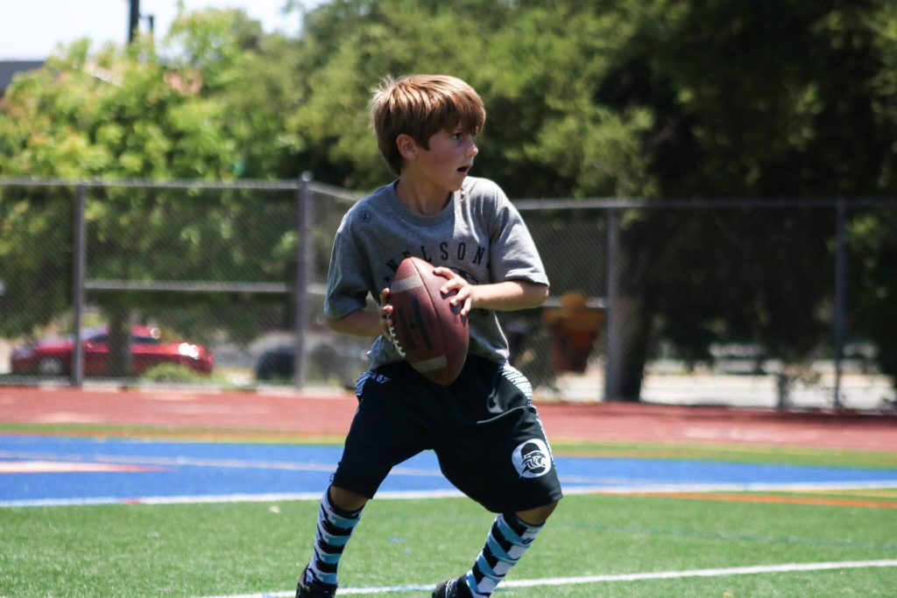
Categorization of Sports in Images
Team Members
CHANDAN MALAMARDI
DHRUV DUA
JAMIE QUOLAS
PRANAY RAO ALLAMPALLI

Slide 2
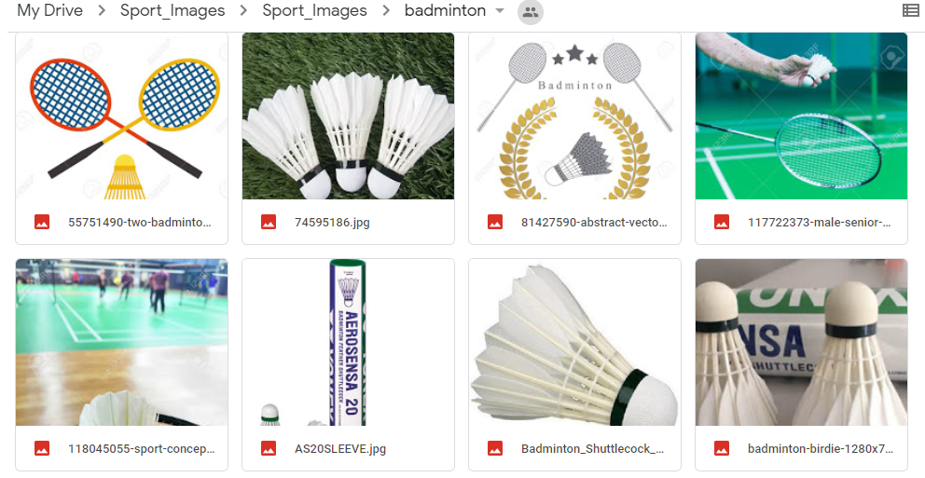
ABOUT THE PROBLEM & DATASET
PROBLEM STATEMENT
Sports industry in the North America has a market capitalization of $75 billion. Sports are very pervasive and penetrating in today’s society. How can marketing companies gain a competitive advantage in this industry? By leveraging the popularity of these sports and images, we explore machine learning algorithms to accurately categorize different sport images.
ABOUT THE DATASET
For Training the model, we are taking images of sports, i.e. Badminton, Table Tennis, Soccer & others from Google Images. Train Images: 250 for each sport & 250 others. Approximately 1000 images.
For Testing the model, we are testing it on 200 images scrapped from the social media & sport blogs.

Slide 3
Implementation Milestones
Level 0: SGD / Single Perceptron / Binary classification
Level 1: Sequential Neural Network / Multi-class classification
Level 2: CNN / Multi-class classification
Level 3: Deployment (End-user interface through Flask)
Level 4: Generalizing the Model

Slide 4
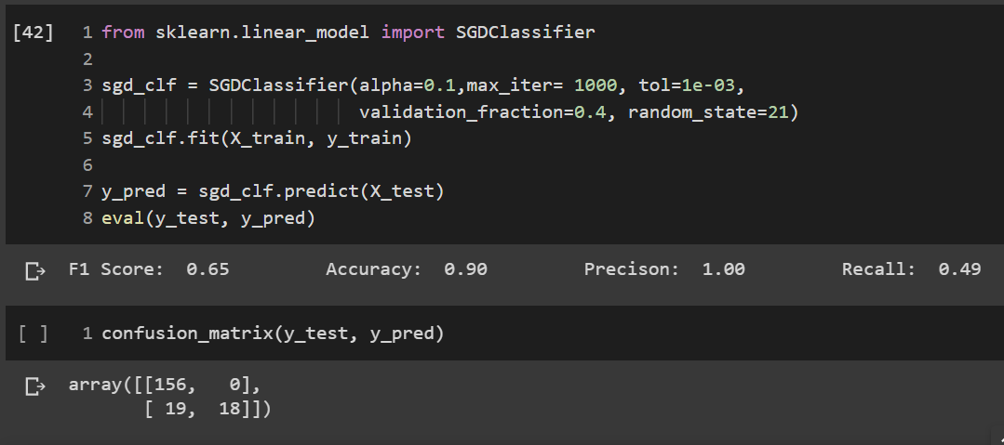
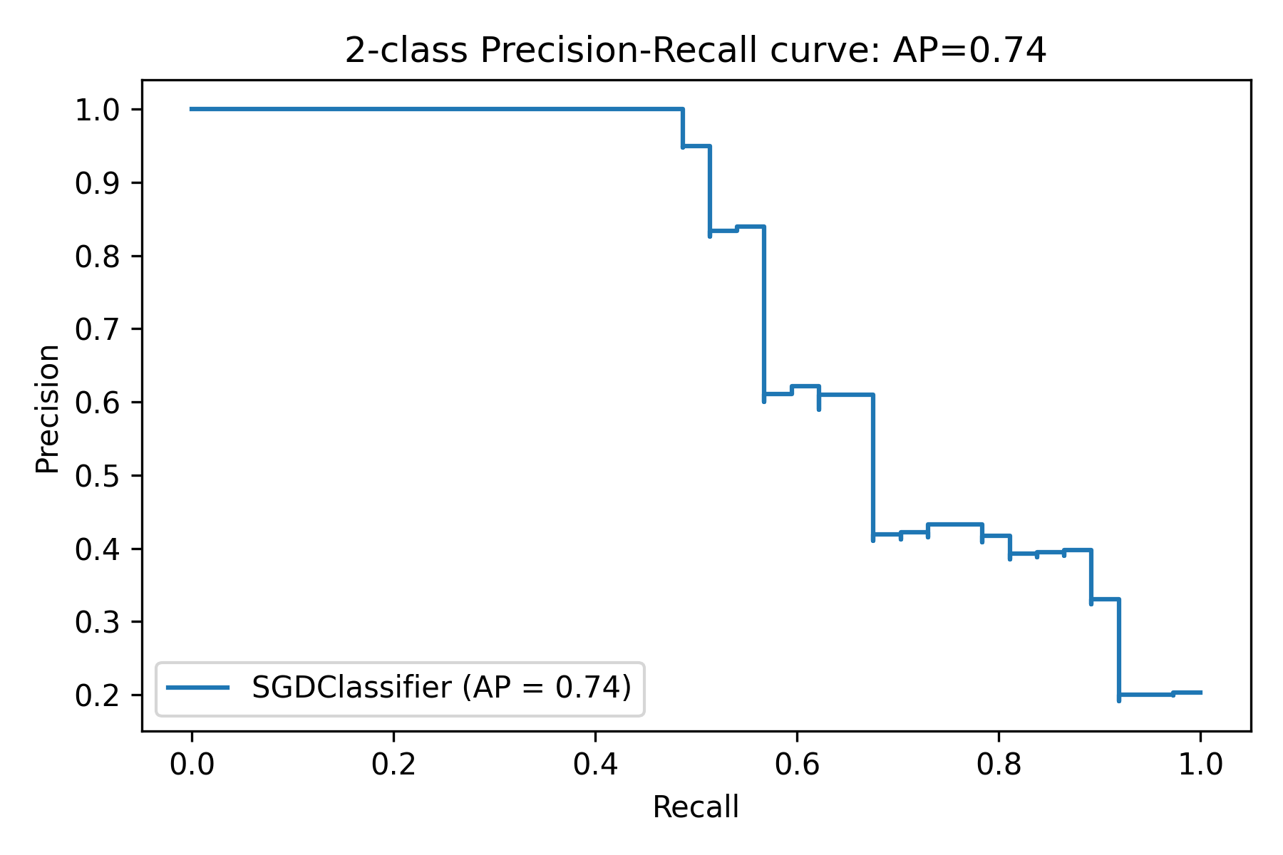
Level 0: SGD

Slide 5
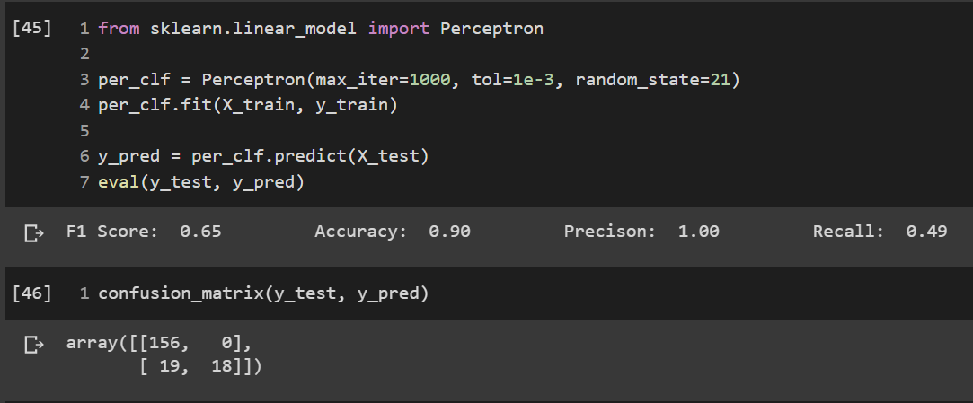
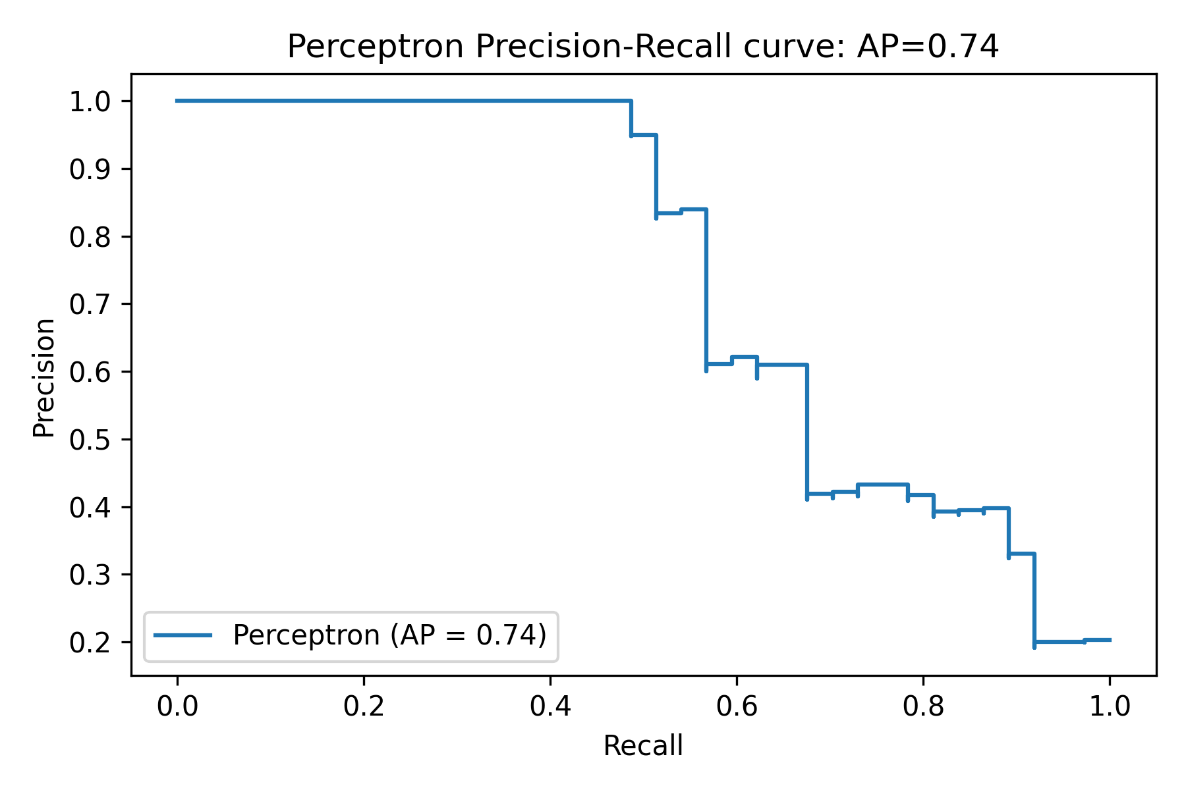
Level 0: Single Layer Perceptron Results

Slide 6
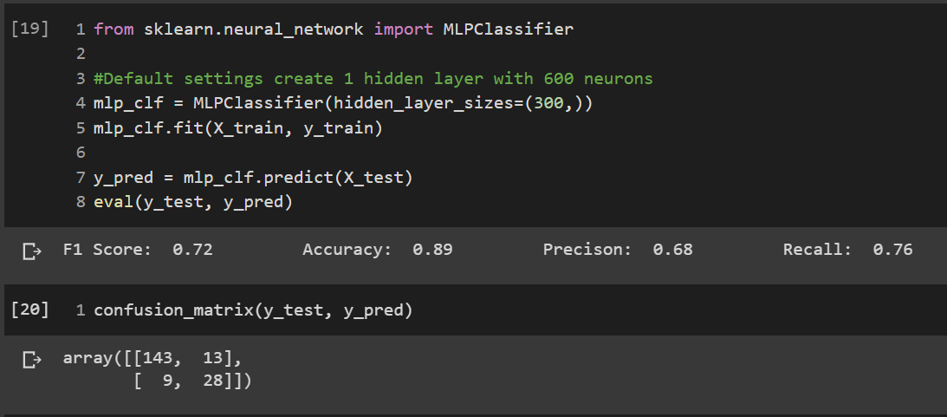
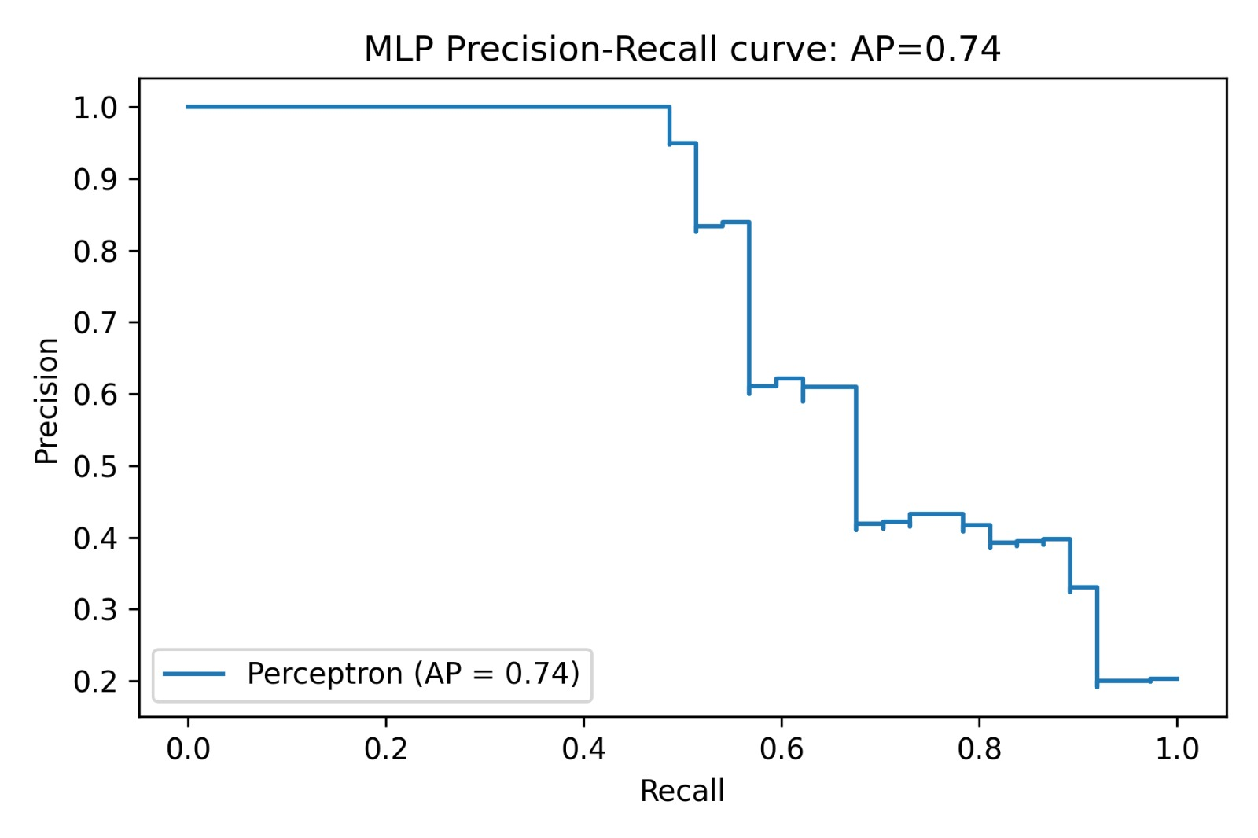
Level 0: MLP Classifier

Slide 7
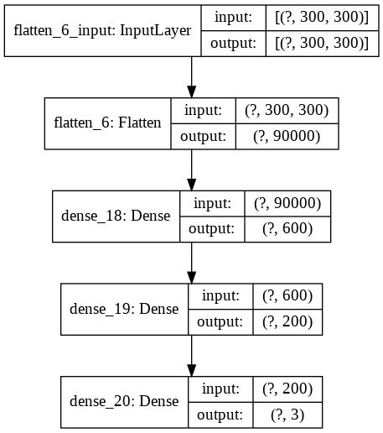
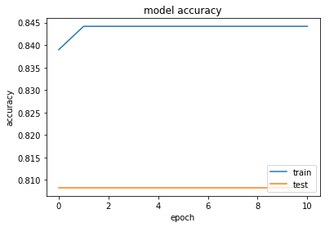
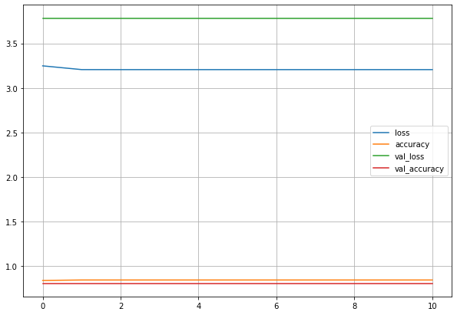
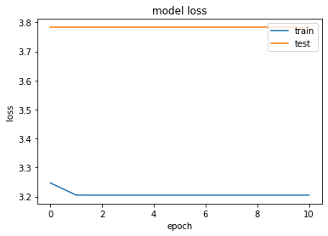
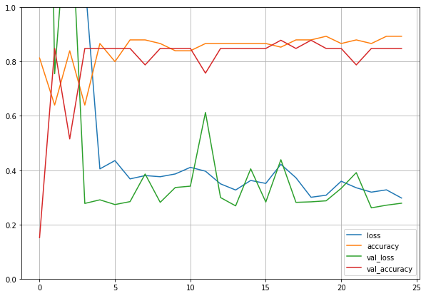
Level 1: Sequential NN Results
Explanation
Code
Accuracy Results
Learning Curve

Slide 8
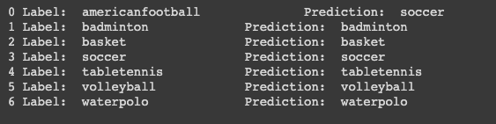
Level 2: Convolutional NN Results

Slide 9
SUMMARY
We gathered images of various sports from the web to train them, we first reshaped the images gathered from URLs.
We then converted images from 3D to 2D, then we shuffle the data to ensure that models remain general and overfits less.
After running the 3 models of SGD classifier, Perceptron algorithm & Sequential Neural Network algorithm we obtained the following results:
MODEL | TRAIN ACCURACY
SGD CLASSIFIER | 90%
PERCEPTRON ALGORITHM | 90%
MLP CLASSIFIER | 89%
SEQUENTIAL NEURAL NETWORKS | 84%
CONVOLUTIONAL NEURAL NETWORK | 99%

Slide 10
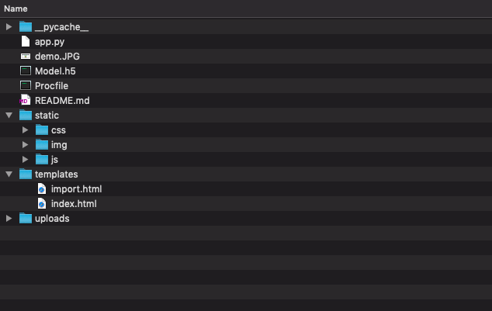
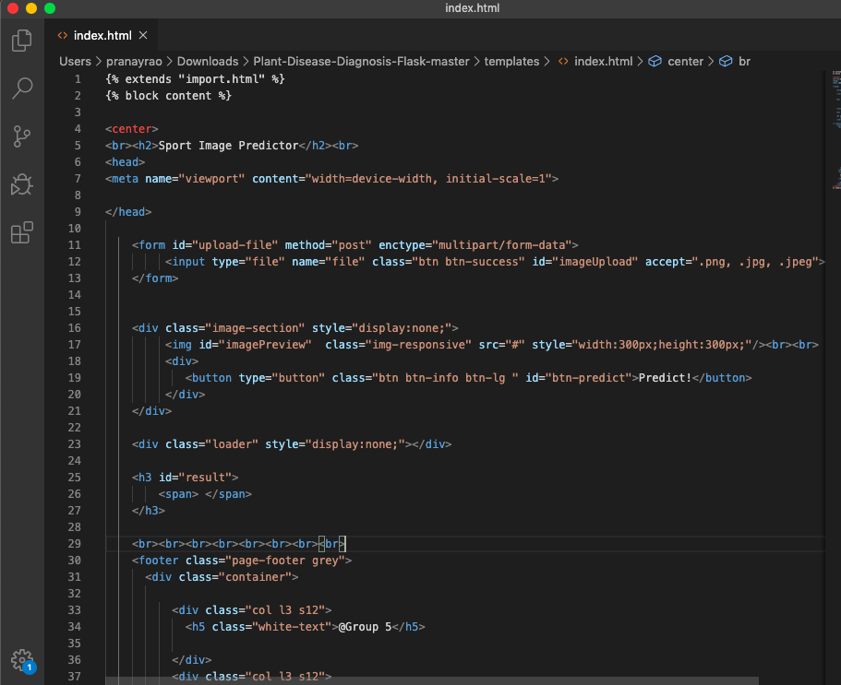
Level 3: Deployment of CNN Model using Flask
To Make the Model Usable
to the End User
Front End Code

Slide 11
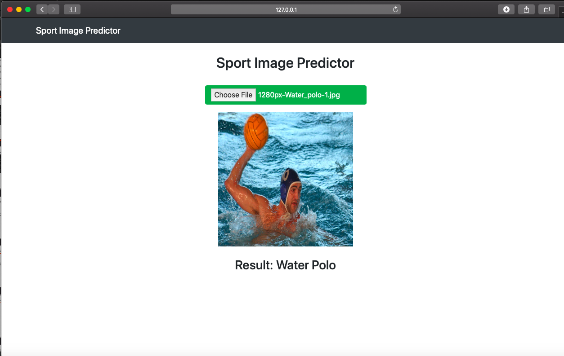
Level 3: Deployment of CNN Model using Flask
User Interface
The Prediction shows Water Polo
We can further detect multiple objects
& displaying it

Slide 12
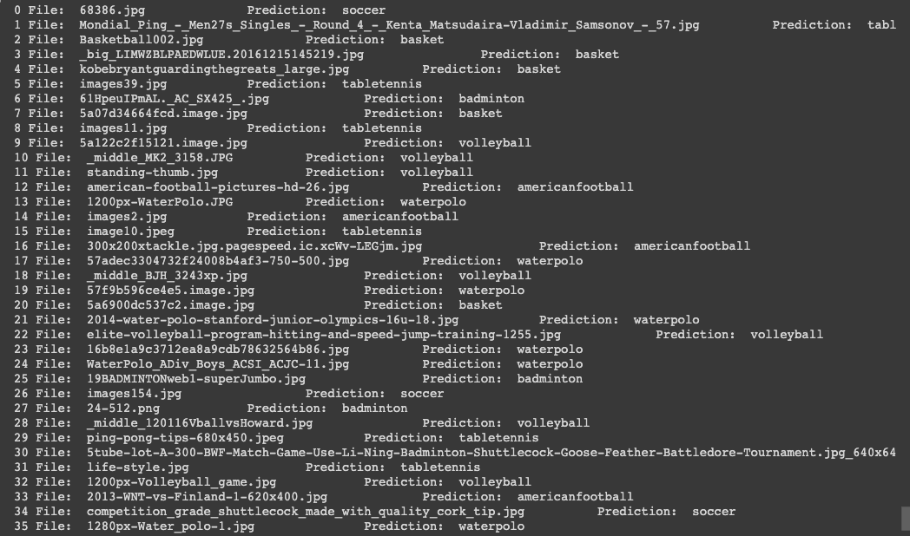
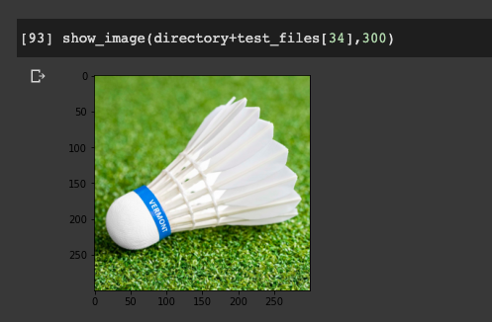
CONCLUSION

Slide 13
FUTURE PLAN – What’s Next
1
Scale Up the Datasets, gather at least 10000 images in Train & then test the CNN model on 400 images scrapped from the social media.
2
We also plan on improving the feature recognition by extracting sport equipment related objects out of the images & saving them in separate directories so as to do a multi object detection & in turn get the best accuracy on new test data.
3
Once the model is tested on the 400 images scrapped from social media. We then plan to fully functional web page which can be used by sport businesses.

